Slide 1
InsightEats Case Study
By: Gabriel Chan
Oct 30, 2025

Slide 2
Agenda
Problem Statement
Architecture Design
Overall Assumptions
Data Discovery
Data Modeling
Pipeline Example
DAG Workflow
Configurable & Modular Pipeline Design
AI Integration
Failure Scenario
Re-visit Architecture Design

Slide 3
Problem Statement
Current Situation
InsightEats currently do not have stable data pipelines needed for traditional Business Intelligence(BI) analytics or future Artificial Intelligence (AI) use cases. There are 3 critical data sources that need to be onboarded which are QuickBite, MealDash and FoodNow.
Solution
Data Exploration and Discovery needed to incorporate into stable data pipelines needed to drive BI and build towards AI usecases.

Slide 4
Architecture Design

Slide 5
Overall Assumptions
working with couriers to develop data contracts
SLA with couriers/ "signing" a contract
menu items may have inconsistent naming (might need mapping)
all currency in USD
There is currently no data architecture for insights and analysts are going directly to sources to infer BI analytics.
The insights on data sources are only what is provided:
QuickBite – REST API with JSON payloads (orders, deliveries, customer actions in near real-time; frequent menu updates)
MealDash – Daily CSV + YAML files via SFTP (revenue, transactions, customer feedback, menu data)
FoodNow – Kafka event streams + XML partner reports (driver statuses, delivery tracking, promotions)
Data sources need to be ingested based on refresh rates

Slide 6
2. Data Exploration & Discovery - Contract/Template
Field | Description | Example
Data Source Name | Name of the partner or system providing the data | QuickBite
Data Owner | Contact person or team responsible for data accuracy | data-team@quickbite.com
Contract Version | Version number for the data contract | v1.2
Effective Date | When this contract takes effect – useful for when this needs to update or if contract is outdated | 2025-10-26
Data Refresh Frequency | How often data is delivered | Near real-time / Daily / Hourly
Delivery Method | How the data is provided | REST API, SFTP, Kafka, Pub/Sub, etc.
Connection Information | API key, OAuth, SSH key, usename/password | OAuth 2.0
Data Schema | Used for validations/monitoring of data | { orderNumber : int orderName: string }

Slide 7
2. Data Exploration & Discovery - QuickBite
Contract Field | Data Source Information
Data Source Name | QuickBite
Data Owner | QuickBite API contact@gmail.com
Contract Version | V1.0
Effective Date | Oct 30,2025
Data Refresh Frequency | Near real-time
Delivery Method | Rest API with Json payloads
Connection Information | API key/token
Data Schema | Will not go further for case study
Notes:
This should be in a json/yaml format to use to validate against when doing pipeline integration and monitoring

Slide 8
2. Data Exploration & Discovery - FoodNow
Contract Field | Data Source Information
Data Source Name | FoodNow
Data Owner | FoodNow_kafka contact@gmail.com
Contract Version | V1.0
Effective Date | Oct 30,2025
Data Refresh Frequency | Kafka event stream ( even based)
Delivery Method | Kafka
Connection Information | Kafka servers with SSL/TLS keys
Data Schema | Will not go further for case study
Notes:
This should be in a json/yaml format to use to validate against when doing pipeline integration and monitoring

Slide 9
2. Data Exploration & Discovery - MealDash
Contract Field | Data Source Information
Data Source Name | Meal Dash
Data Owner | Mealdash_csv@gmail.com
Contract Version | V1.0
Effective Date | Oct 30,2025
Data Refresh Frequency | Daily
Delivery Method | CSV + YAML files
Connection Information | SFTP passwordless or username/password auth
Data Schema | Next slide
Notes:
This should be in a json/yaml format to use to validate against when doing pipeline integration and monitoring

Slide 10
2. Data Exploration & Discovery - MealDash - Cont
{
"data_source_name": "MealDash",
"data_owner": "mealdash_csv@gmail.com",
"contract_version": "v1.0",
"effective_date": "2025-10-30",
"data_refresh_frequency": "daily",
"delivery_method": "CSV + YAML files",
"connection_information": {
"protocol": "SFTP",
"authentication_methods": ["passwordless", "username_password"],
"notes": "Preferred method: SSH key-based (passwordless).",
"host": "sftp.mealdash.com",
"username": "ftp_user",
"password_secret_name": "ftp-password-secret",
"file_path": "/path/to/data.csv",
"s3_destination": "s3://my-bucket/ftp_data/"
},
"data_schema_reference": "mealdash_schema_v1.json",
"description": "Daily delivery of MealDash order, revenue, feedback, and menu data to InsightEats. Delivered via secure SFTP as CSV and YAML metadata files."
}
Notes:
This should be in a json/yaml format to use to validate against when doing pipeline integration and monitoring

Slide 11
2. Data Exploration & Discovery - MealDash – Data Schema
{
"orders": [
{ "name": "order_id", "datatype": "bigint", "required": true },
{ "name": "menu_id", "datatype": "bigint", "required": true },
{ "name": "revenue_id", "datatype": "bigint", "required": true },
{ "name": "quantity", "datatype": "integer", "required": true },
{ "name": "price", "datatype": "double", "required": true },
{ "name": "promotion_id", "datatype": "bigint", "required": false }
]
}
Notes:
This should be in a json/yaml format to use to validate against when doing pipeline integration and monitoring

Slide 12
4. Data Modelling
QuickBite
Orders, deliveries, customer actions, frequent menu updates
MealDash
Revenue, transactions, customer feedback, menu data
FoodNow
Driver statuses, delivery tracking, promotions
Assumption: All courier platforms need to have some sort of customer information, transaction/revenue information, menu information, delivery tracking, restaurant and promotions to function.

Slide 13
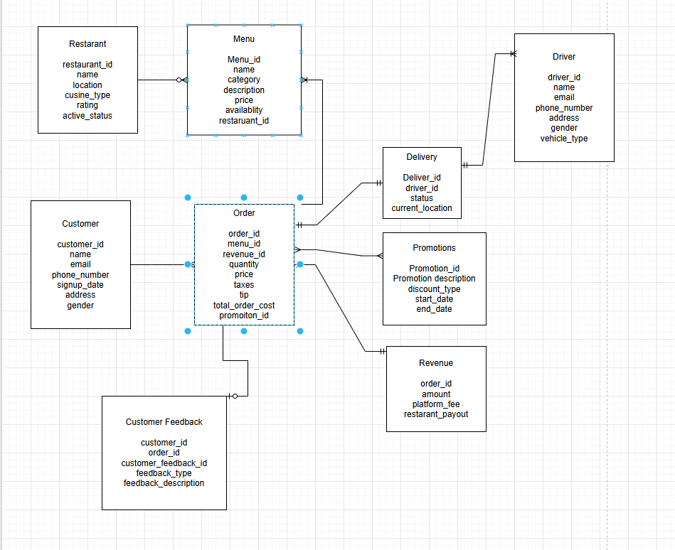
4. Data Modelling - Tables
Notes:
Task more towards orders and menus

Slide 14
Order Table
Name | Datatype | Description
order_id | STRING / UUID | Unique identifier for each order.
menu_id | STRING / UUID | Identifier referencing the menu item associated with the order.
revenue_id | STRING / UUID | Foreign key linking to the corresponding revenue record.
quantity | INTEGER | Number of units of the menu item ordered.
price | DECIMAL(10,2) | Price per unit of the menu item at the time of order.
taxes | DECIMAL(10,2) | Taxes
tip | DECIMAL(10,2) | Customer tips
total_order_cost | DECIMAL(10,2) | Total cost of the order
promotion_id | STRING / UUID | Identifier referencing any promotion applied to the order.

Slide 15
Menu Table
Name | Datatype | Description
menu_id | STRING / UUID | Unique identifier for each menu item.
name | STRING | Name of the menu item.
category | STRING | Category of the menu item (e.g., appetizer, main course, beverage).
description | STRING / TEXT | Detailed description of the menu item.
price | DECIMAL(10,2) | Price of the menu item.
availability | BOOLEAN | Indicates whether the menu item is currently available.
restaurant_id | STRING / UUID | Identifier referencing the restaurant offering the item.

Slide 16
Revenue Table
Name | Datatype | Description
order_id | STRING / UUID | Unique identifier referencing the associated order.
amount | DECIMAL(10,2) | Total revenue generated from the order before fees.
platform_fee | DECIMAL(10,2) | Fee charged by the delivery platform for processing the order.
restaurant_payout | DECIMAL(10,2) | Net amount paid to the restaurant after deducting platform fees.

Slide 17
Delivery Table
Name | Datatype | Description
delivery_id | STRING / UUID | Unique identifier for each delivery.
driver_id | STRING / UUID | Identifier for the driver assigned to the delivery.
status | STRING | Current status of the delivery (e.g., pending, in_transit, delivered).
current_location | STRING / JSON | Real-time location of the driver or delivery, typically in coordinates.

Slide 18
Data Ingestion
Broken by data source types, for each type there should be a separate system.
REST API (JSON Format input)
Flat files (CSV or YAML)
Kafka
Handling schema drift can be handled through the data contracts on data schemas and enforcing strict typing only when standardizing
Json, csv and yaml files can be ingested to data lakes/Amazon s3 buckets as an initial phase then use AWS glue data catalog for scanning
Notes:
Can use aws glue dynamicframe method

Slide 19
Data Ingestion - Flat files (CSV or YAML)
Feature / Aspect | Amazon EMR | AWS Batch | AWS Glue
CSV Transformation | Optimized for large-scale transformations using Spark/Hive; handles multiple CSVs in parallel | Must implement transformation in container/script; can process CSVs sequentially or concurrently | Native ETL using PySpark; can read multiple CSVs from S3, transform, and write back to S3/Redshift
Data Size Handling | Best for medium → very large datasets (GB → TB) | Small → medium datasets (MB → few GB per job) | Medium → large datasets (GB → TB), serverless Spark handles parallelism
Parallelism / Scalability | Auto-distributes across cluster nodes; excellent for multiple CSVs | Can run multiple jobs concurrently; scaling is manually configured | Auto-parallelizes using DPUs; handles multiple CSVs in parallel
Incremental / Streaming | Spark Streaming jobs possible for incremental CSV updates | Each job is batch-triggered; no native streaming | Glue Streaming jobs available for near-real-time CSV ingestion
Schema Handling | Schema inference supported; can validate CSV headers & data types automatically | Must implement manually in script | Schema inference, validation, and catalog integration with Glue Data Catalog
Automation | Step Functions, Glue, or EMR scheduled jobs | Job queues, Step Functions, EventBridge triggers | Built-in job scheduler, workflow orchestration, and triggers
Cost Considerations | Pay for EC2 instances + EBS + EMR fees; good for large CSVs | Pay for underlying compute resources; cheaper for small CSV batches | Pay per DPU-hour + storage; serverless and cost-efficient for medium-large CSV loads
Typical Workflow | S3 → EMR Spark → transformed data → S3/Redshift | S3 → Batch job container → output to S3/Redshift | S3 → Glue ETL job → S3/Redshift
Notes:
Good contender aws transfer family directly to S3 bucket

Slide 20
Data Ingestion - Flat files (CSV or YAML)
Justification for AWS Batch: AWS Batch is the ideal choice for processing small-to-medium CSV workloads because it provides a cost-effective, flexible, and easy-to-manage solution. Unlike EMR or Glue, it does not require managing clusters or provisioning DPUs, which would be unnecessary overhead for this scale. Batch allows each CSV file or batch of files to be processed independently in containers, enabling parallel execution when needed, while keeping costs predictable. It also integrates easily with scheduling and event-driven workflows, making it well-suited for daily ingestion pipelines with lightweight transformations. Overall, AWS Batch meets the current workload’s scale, complexity, and budget efficiently.

Slide 21
Data Ingestion - REST API (JSON Format input)
Criteria for choosing ingestion pipeline technology
Cost
Reliability
Scalability

Slide 22
Data Ingestion - Flat files (CSV or YAML)
Criteria for choosing ingestion pipeline technology
Cost
Reliability
Scalability

Slide 23
Data transformation pseudocode
Using configurable yaml files with Amazon redshift sql queries to transform from raw to standardization
Imposing proper datatypes
Having true nulls
Trimming whitespaces
Using DAGS to call on ingestion pipelines and sql pipelines passing on parameters

Slide 24
Further Insights Needed
What is the quantity that we need to ingest per load averagely
Can be added to data contract
What are the actual fields present within each data source and do we need them all
Is historical data needed?
What is the retention time for the data? (for this case study assuming 2 years max)
What is the true purpose for monitoring revenue, performance and customer actions? ( for case study assuming its for time to insight for quicker and more efficient business decisions, example: what is the business’ core customer base demographic, which promotion is most used by customers)

